Slide 1
Store Sales Analysis
Analyzing Key Sales Patterns
Harsh Peshwani

Slide 2
Sales and Store Insights
This presentation focuses on analyzing sales trends, customer preferences, and return rates. We’ll identify key revenue-driving products and markets that can help us optimize our strategies.
This analysis and insights were derived using SQL, Power BI, and Python, leveraging data processing, visualization, and reporting techniques to extract meaningful trends

Slide 3
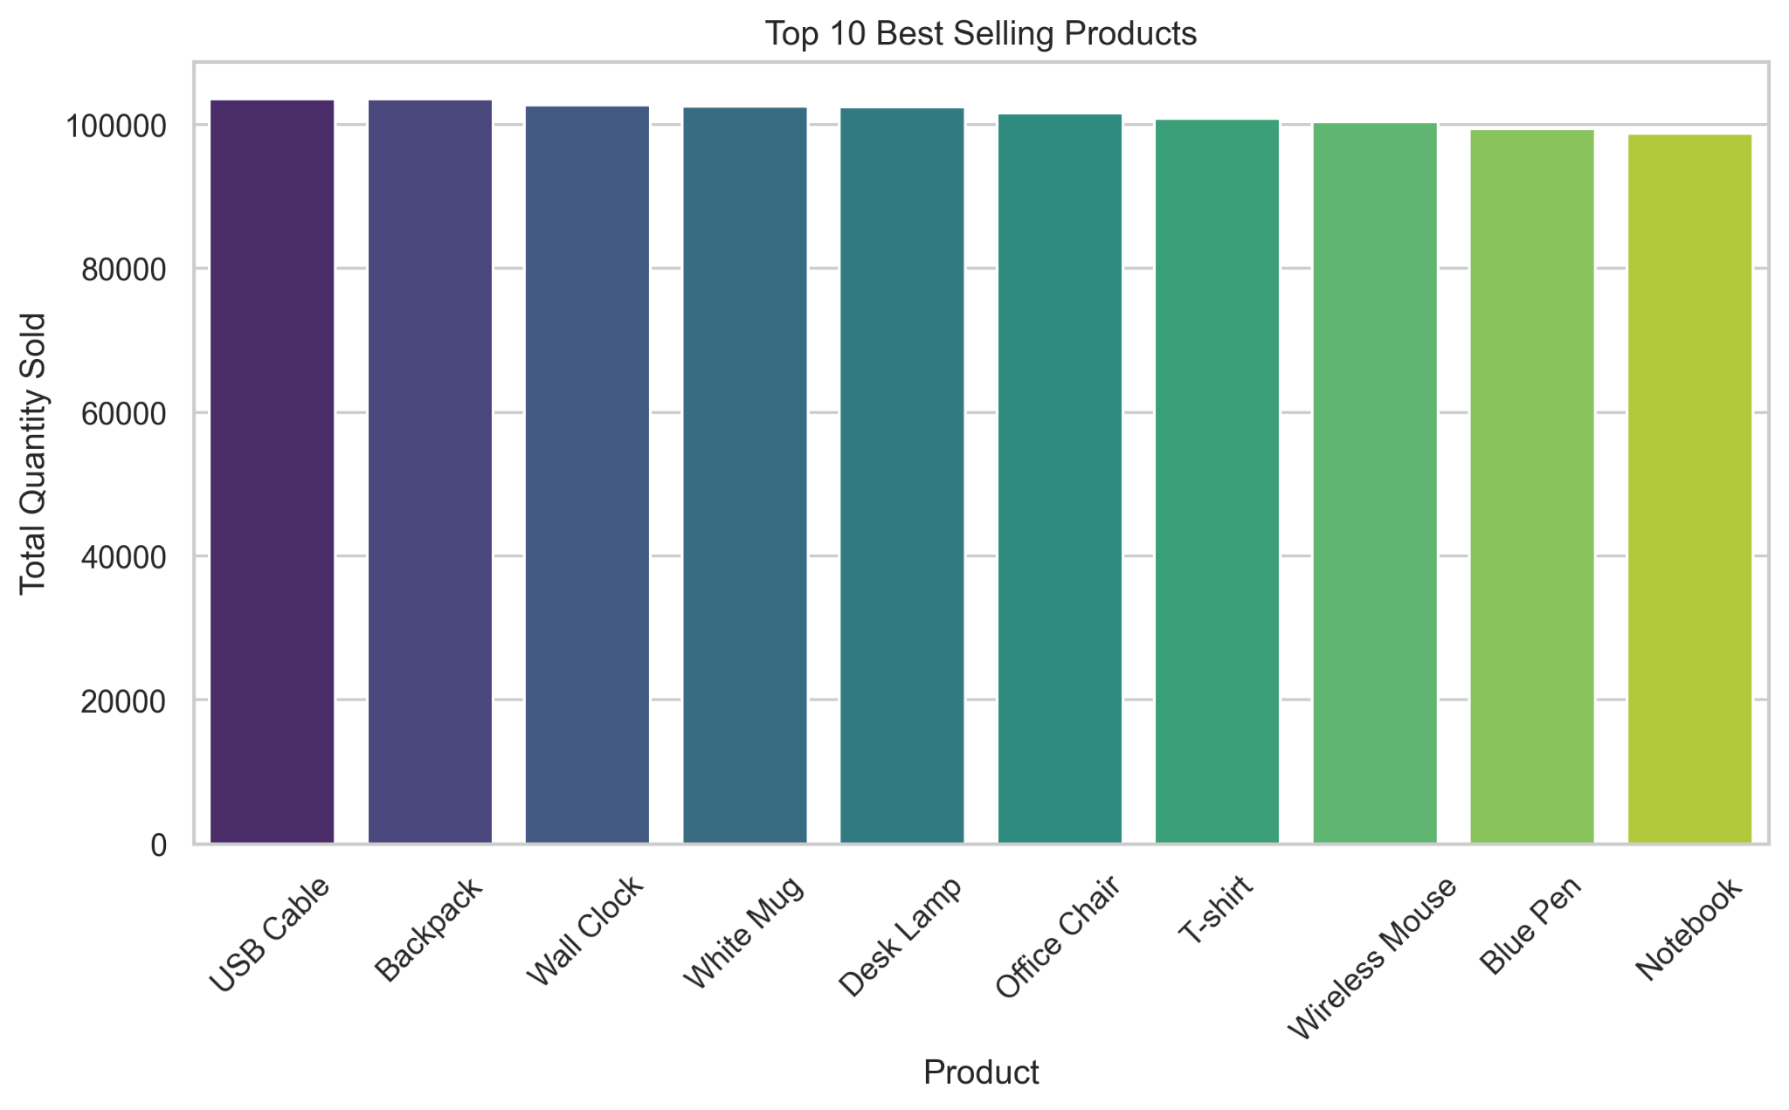
Top 10 Best Selling Products

Slide 4
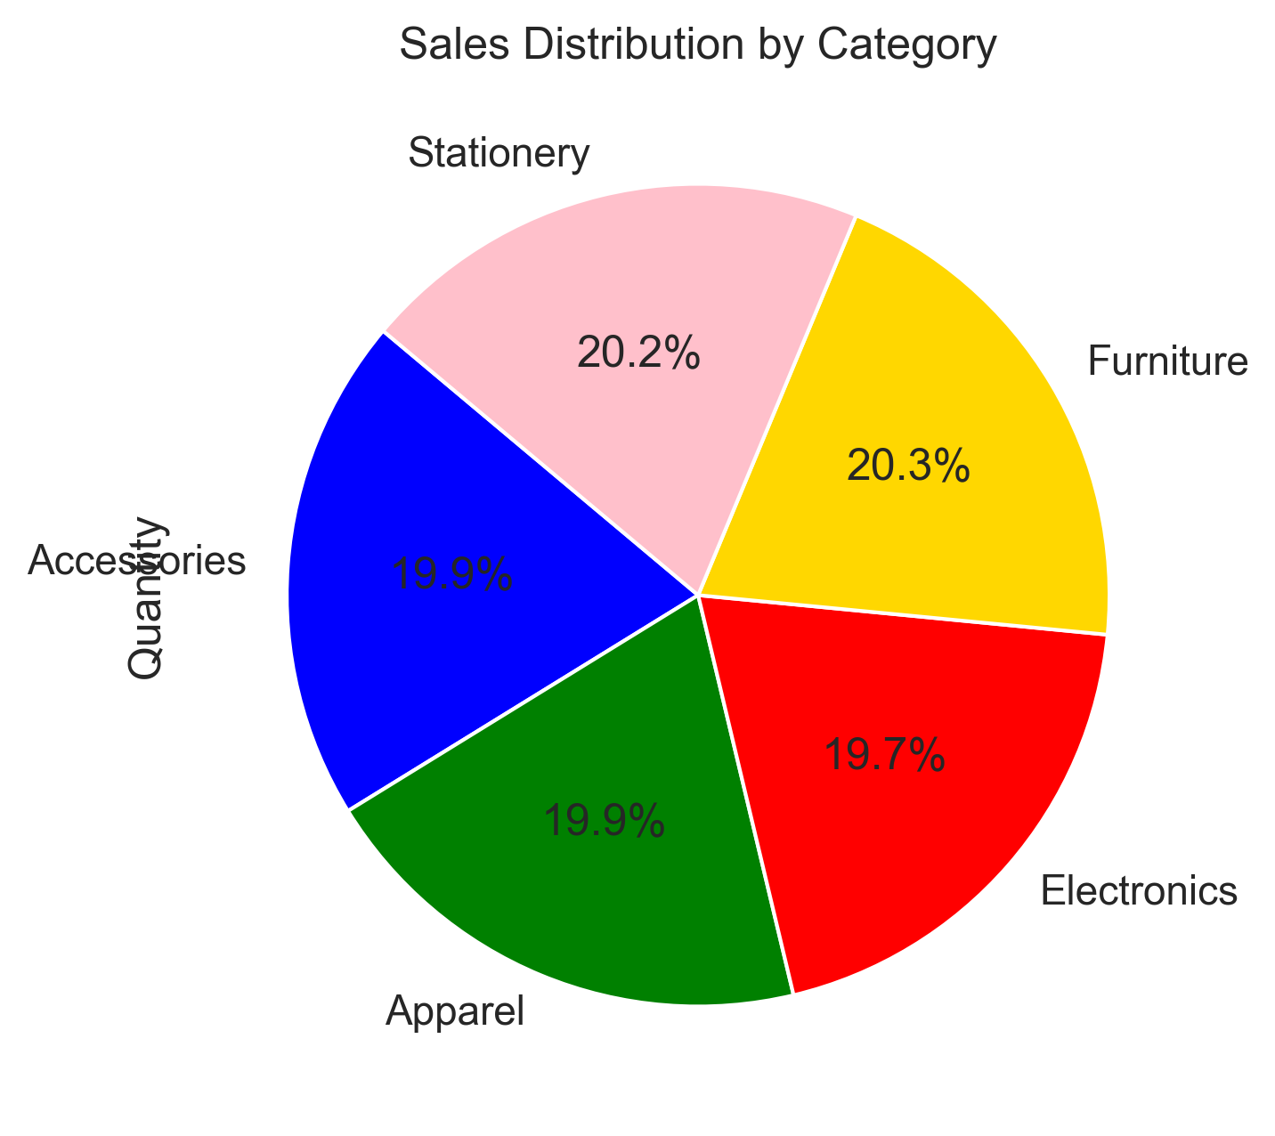
Sales Distribution by Category

Slide 5
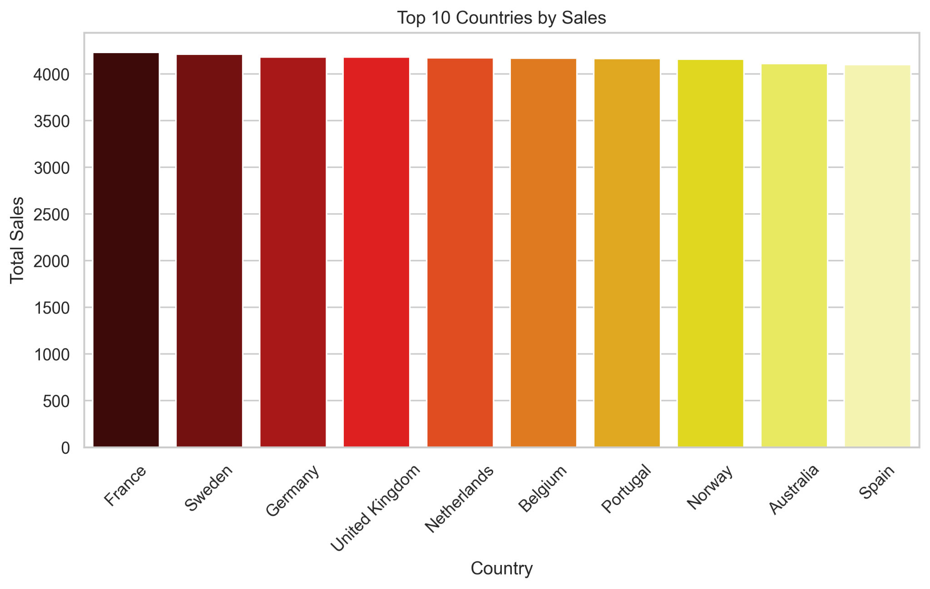
Top 10 Countries by Sales

Slide 6
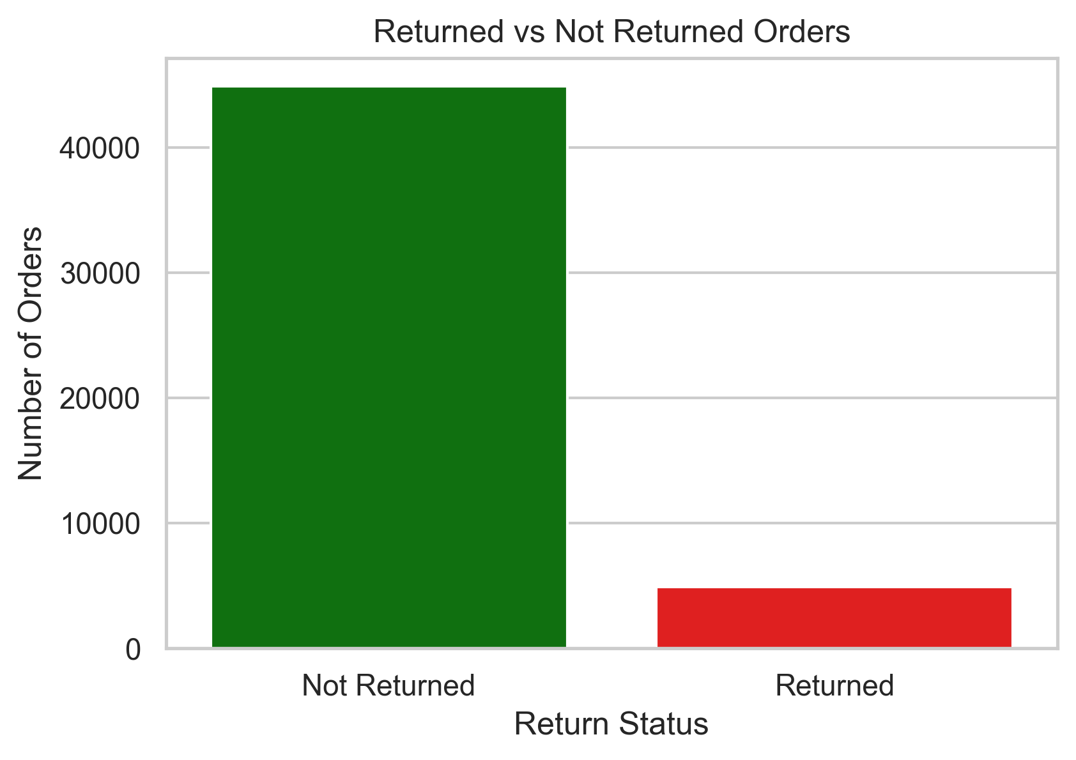
Return Analysis

Slide 7
Conclusion
Key Findings:
✅ Sales are well-distributed across multiple product categories.
✅ Returns are minimal, indicating high customer satisfaction, but can be further optimized.
✅ Certain products and countries drive the majority of sales, presenting growth opportunities.
Business Recommendations:
📌 Boost marketing efforts in high-selling categories to maximize revenue.
📌 Analyze return reasons to identify patterns and reduce return rates.
📌 Expand in high-growth regions based on sales trends and market potential.

